Slide 1
Project Meeting Presentation

Slide 2
Previously
Had looked into alignment of prediction and options markets.
Low volume lead to poor/speculative results.
Potential data source is unusable (stolen).

Slide 3
New Work
Heard anecdote about horse betting strategy.
New dataset (71,000 races).

Slide 4
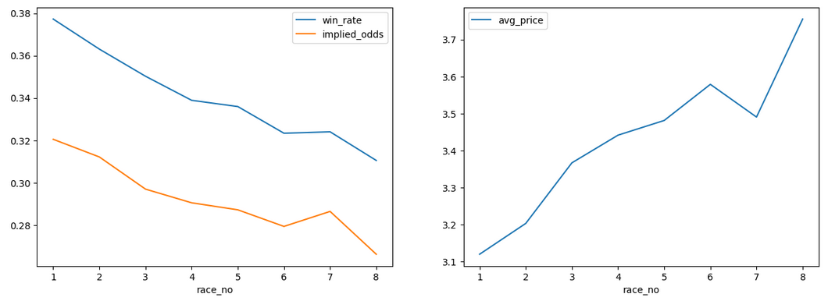
Win Rate Per Race

Slide 5
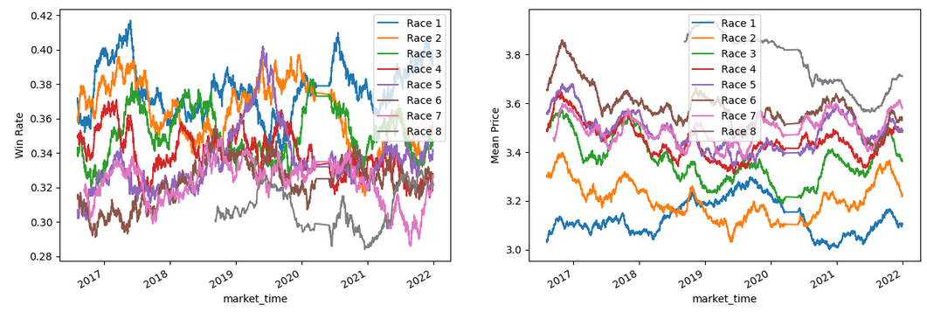
Win Rate Per Race Over Time

Slide 6
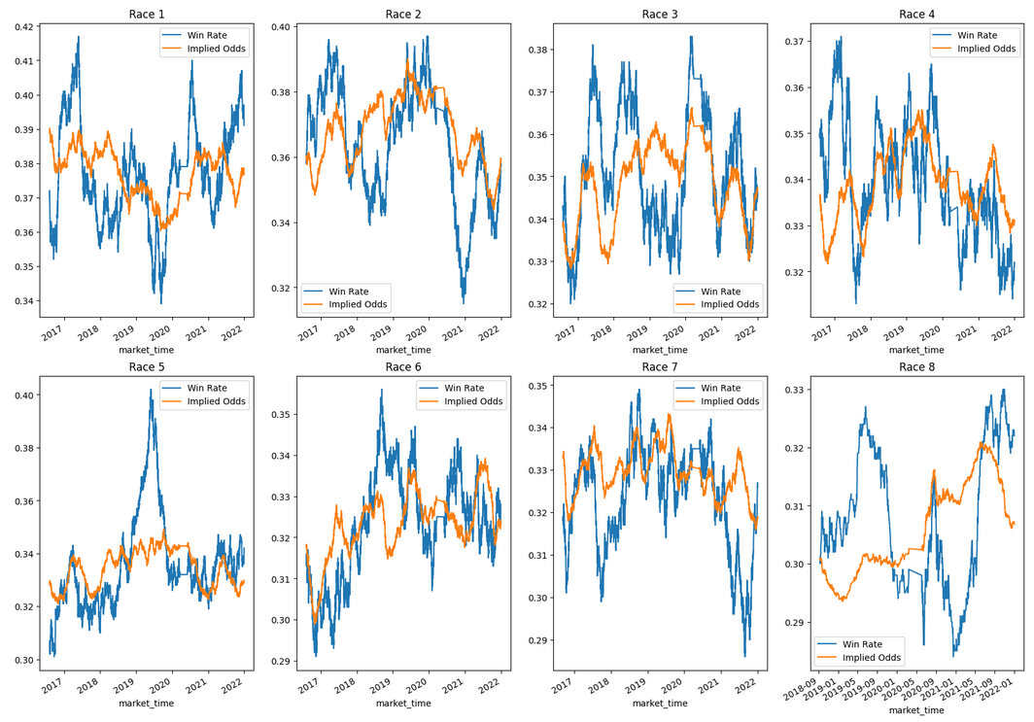
Win Rate Against Implied Odds

Slide 7
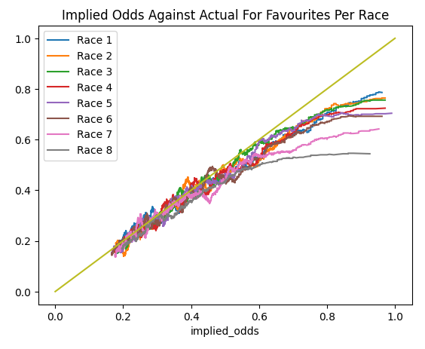
Implied Odds Against Actual

Slide 8
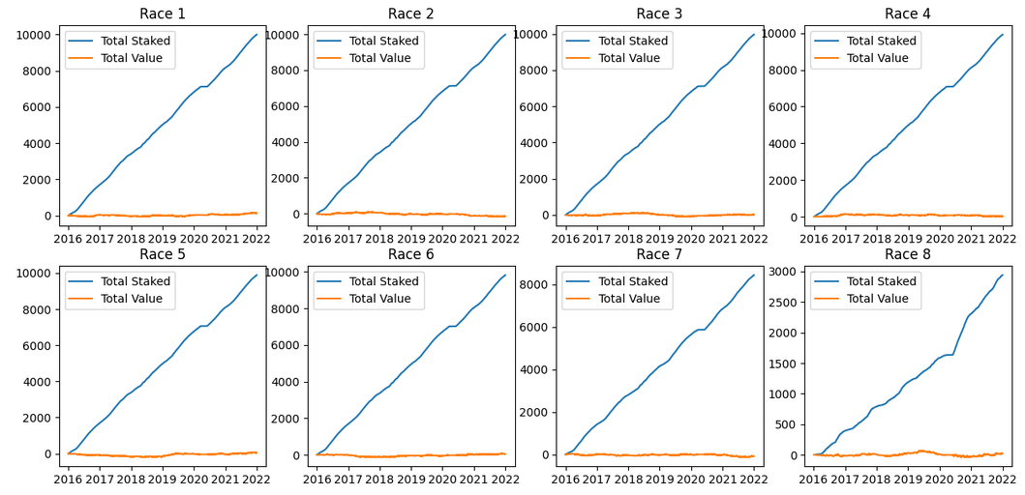
Betting On The Favourite

Slide 9
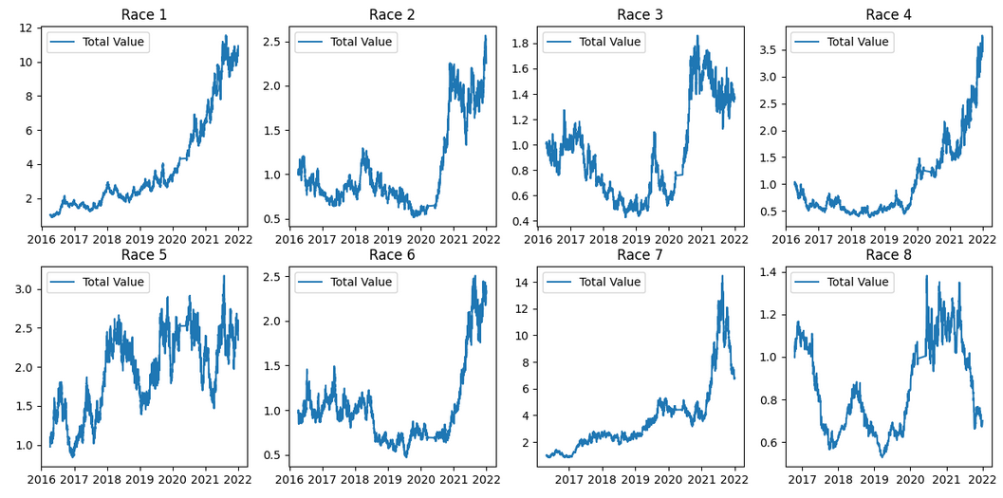
Using Kelly-Criterion To Size Bets

Slide 10
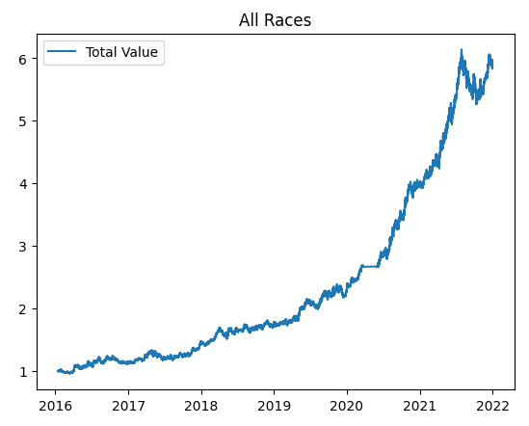
Using Kelly-Criterion To Size Bets

Slide 11
Caveats
Hard to place large bets at starting price.
Data is not separated by 7/8 race events.
Learning algorithm uses the favourite win rate, not the implied-actual odds curve.

Slide 12
Next Steps
Look into existing research regarding this feature.
Larger data sets – potential larger set of start price data available back to 2008. Also data from outside GB/IE.
Compare parameters for learning algorithm (window size, bet size).
Measure more concretely than just comparing graphs.

